Slide 1
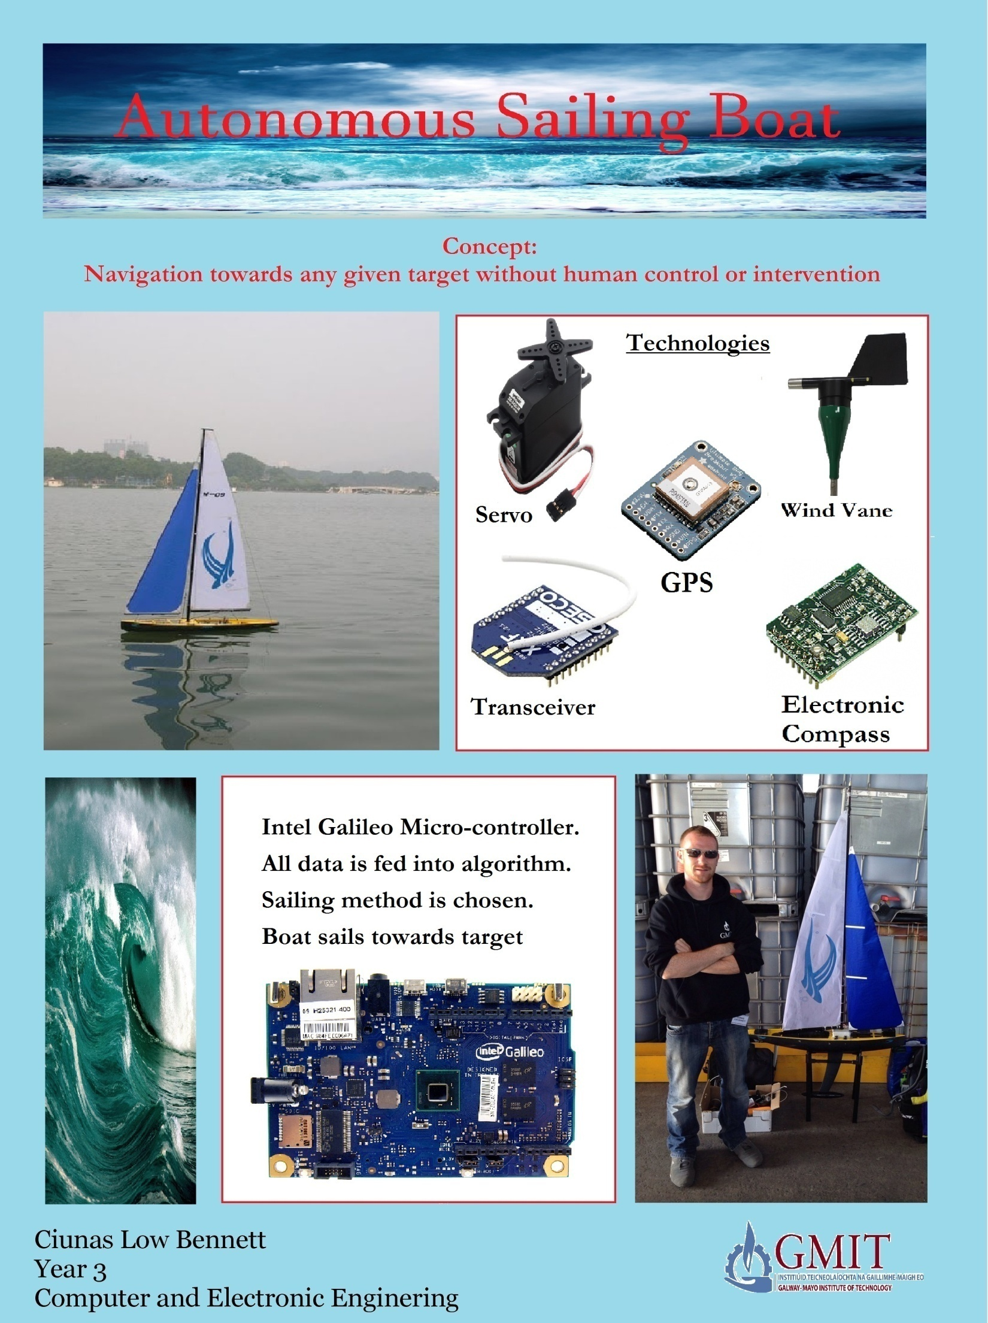

Slide 2
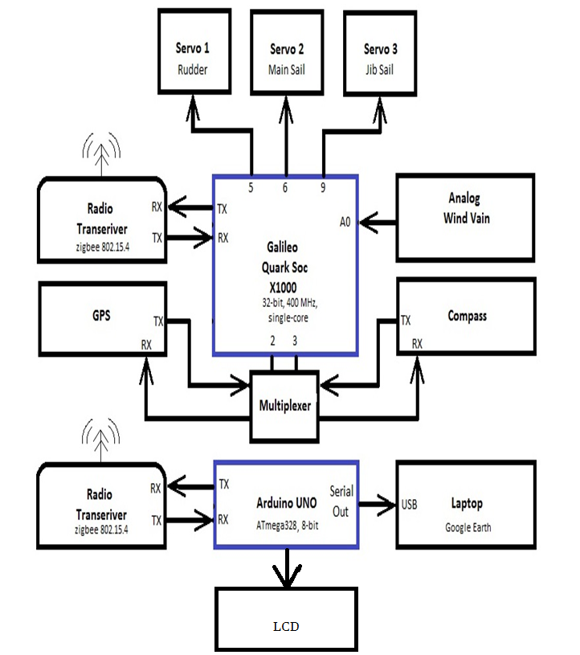
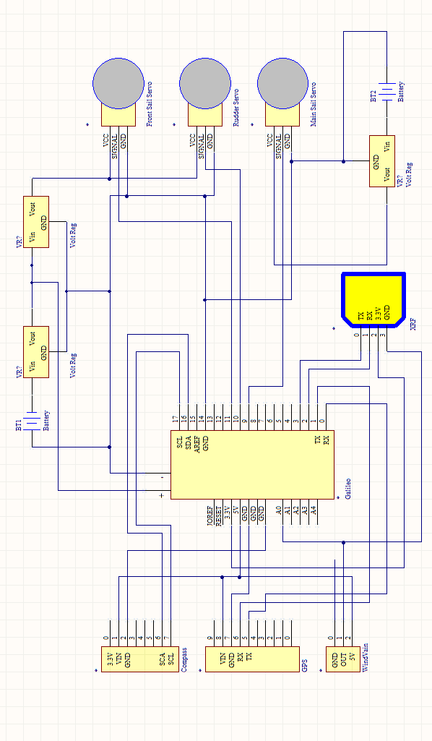
Block Diagram of Boats Control System

Slide 3
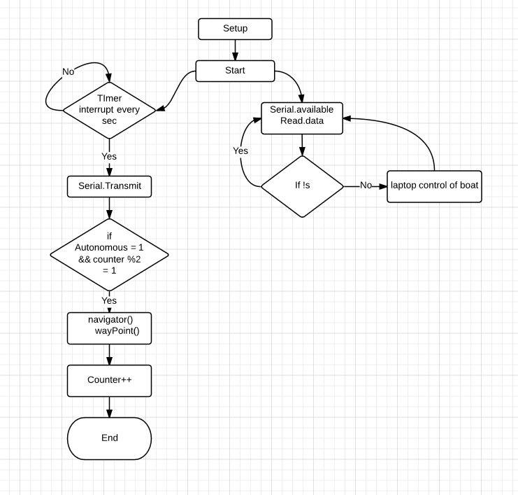
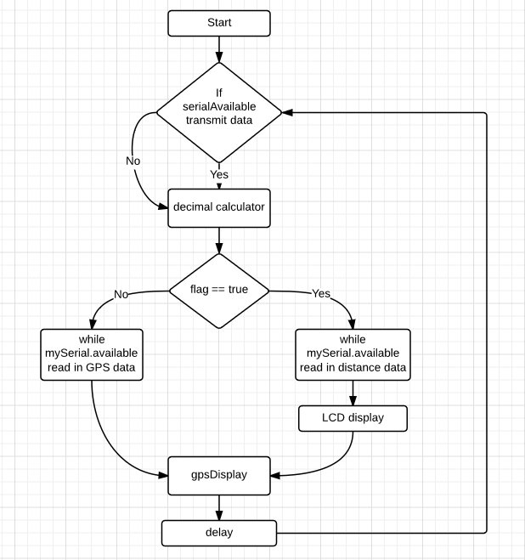
High Level Flowchart
Boat Flow Chart
Receiver Flow chart

Slide 4
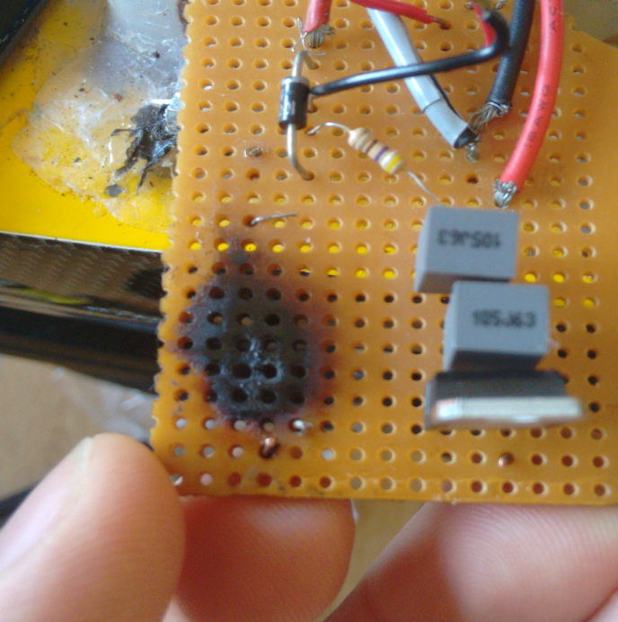
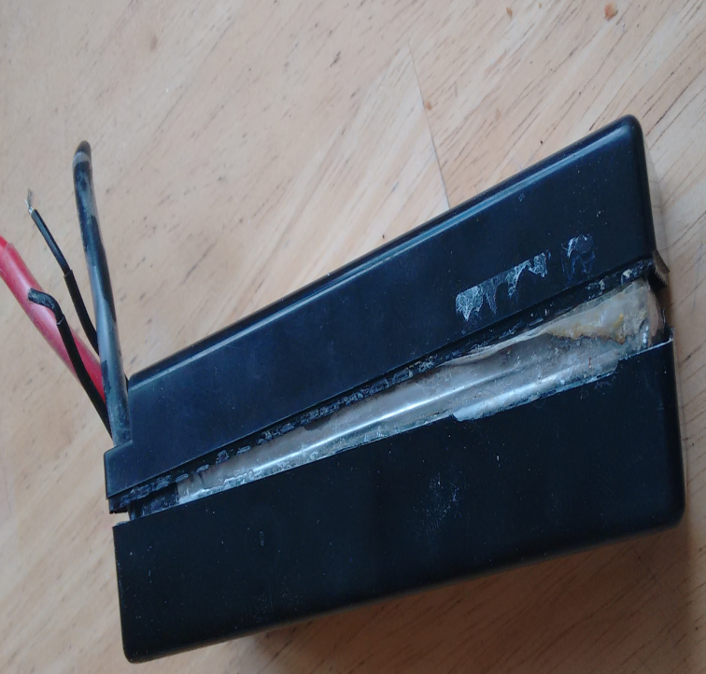
Problems I have Encountered
When components fail
there can be catastrophic
failure. This is where a
transistor has overheated
and caught on fire. This was
caused by lack of an
appropriate heat sink.
Other problem such as
battery failures are hard
to predict but can happen.
Lucky this battery did not
go on fire. Lithium batteries
are know to spew toxic
chemicals when they fail.

Slide 5


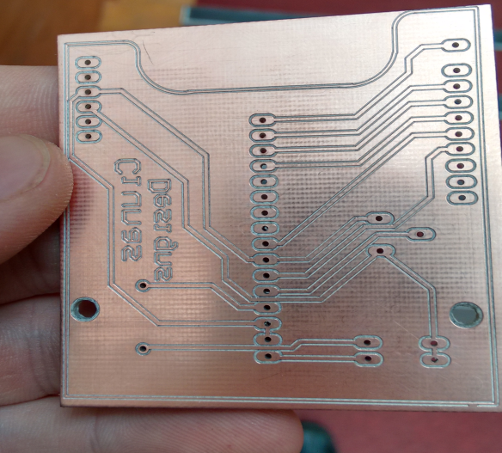
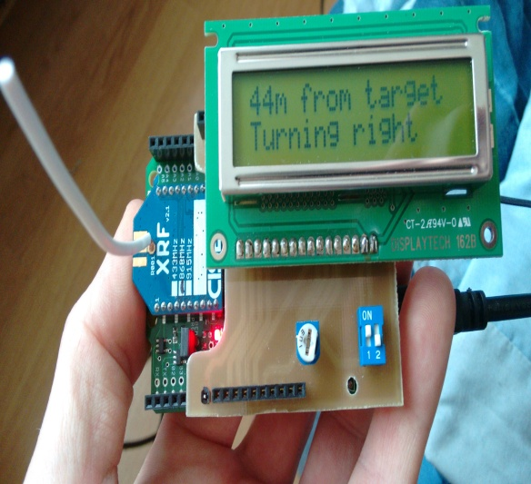
Achievements
Feedback informing the user what the boat is doing.
Live updating of position of boat to Google Earth.
Remote Control from laptop (steering and turning on/off autonomous mode).
Designing and making an LCD shield.
More efficient and streamlined code.
Galileo board wired into boat

Slide 6

Thank You

